Slide 1


Department of Computer Science and Engineering
GE19612-Professional Readiness for Innovation,Employability and Entrepreneurship
AI FitHub
Revolutionizing Wellness with Intelligent Fitness Guidance
Mohamed Hussain
210701161
Mukkundhan N
210701170
Nathaniel Abishek A
210701173
Dr . K.Ananthajothi M.E.,Ph.D.,
Professor

Slide 2
Abstract
AI FitHub is a pioneering platform dedicated to revolutionizing wellness through intelligent fitness guidance. Leveraging cutting-edge artificial intelligence (AI) technologies, AI FitHub offers personalized fitness solutions tailored to individual needs, preferences, and goals. By analyzing user data, the platform delivers customized diet plans, nutrition recommendations, and motivational support to optimize fitness outcomes. AI FitHub focuses on well being of the user by providing a well suitable diet for the individual considering the health factors of the user. It aims on combining advanced AI technologies on user-centric design. The main objective of AI FitHub is to transform the fitness industry, making personalized wellness accessible to all.

Slide 3
Existing System
The existing systems for fitness and nutrition tracking, such as MyFitnessPal and Fitbit, offer basic features for logging meals, tracking workouts, and monitoring overall health metrics. These platforms provide users with calorie counts, nutrient breakdowns, and generalized exercise routines. However, they can be time-consuming and prone to inaccuracies. The insights and recommendations provided are often generic and not tailored to individual users' specific health conditions, preferences, or goals. Real-time, adaptive feedback based on continuous data monitoring is generally not available. Privacy concerns also persist, as user data is often stored in centralized databases, potentially exposing it to security risks.

Slide 4
Proposed System
AI FitHub offers an advanced AI-driven solution that customizes nutrition plans based on individual user data, preferences, and health conditions. The platform uses advanced AI algorithms to analyze data collected from various sources, ensuring accurate and up-to-date insights without the need for sensitive personal information input. AI FitHub dynamically adjusts its recommendations in real-time based on continuous user feedback and progress, optimizing outcomes. The integration of data from diverse sources provides a comprehensive health view, enhancing the accuracy of analysis. The platform features a simple user interface, and uses advanced AI techniques like reinforcement learning and natural language processing to deliver personalized insights. User privacy and data security are prioritized, ensuring robust protection and ethical handling of user data, thereby building trust in AI-driven fitness solutions.

Slide 5
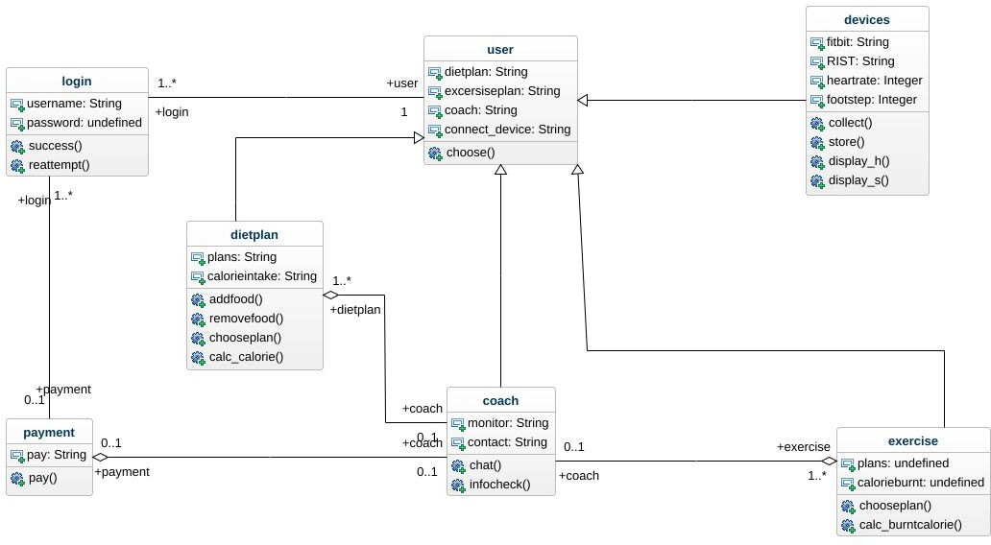
System Architecture

Slide 6
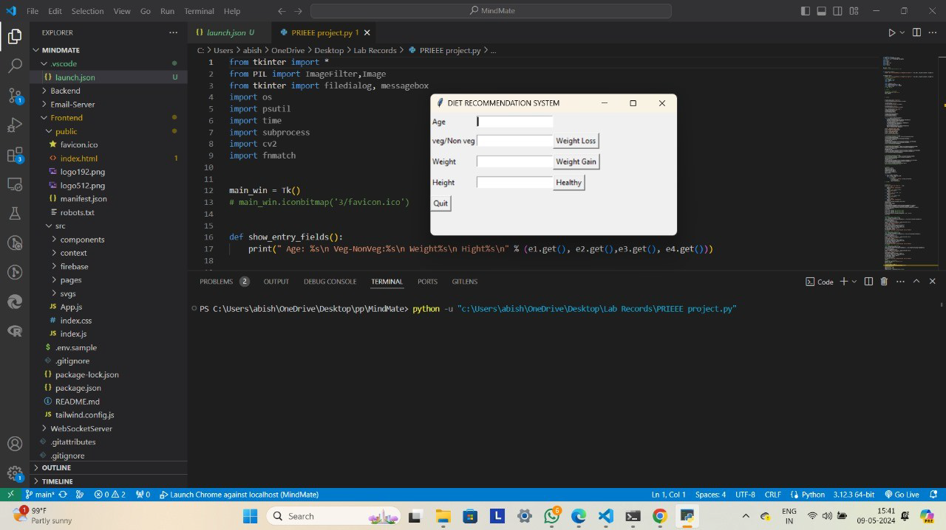
Implementation

Slide 7
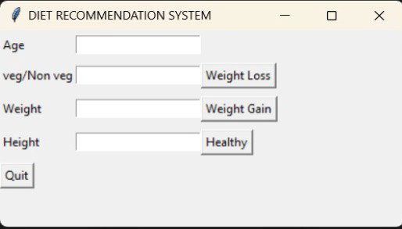
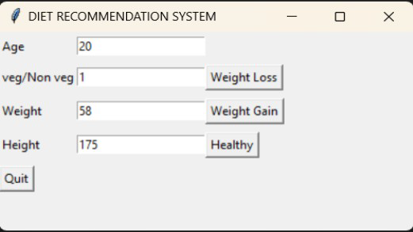
Implementation

Slide 8
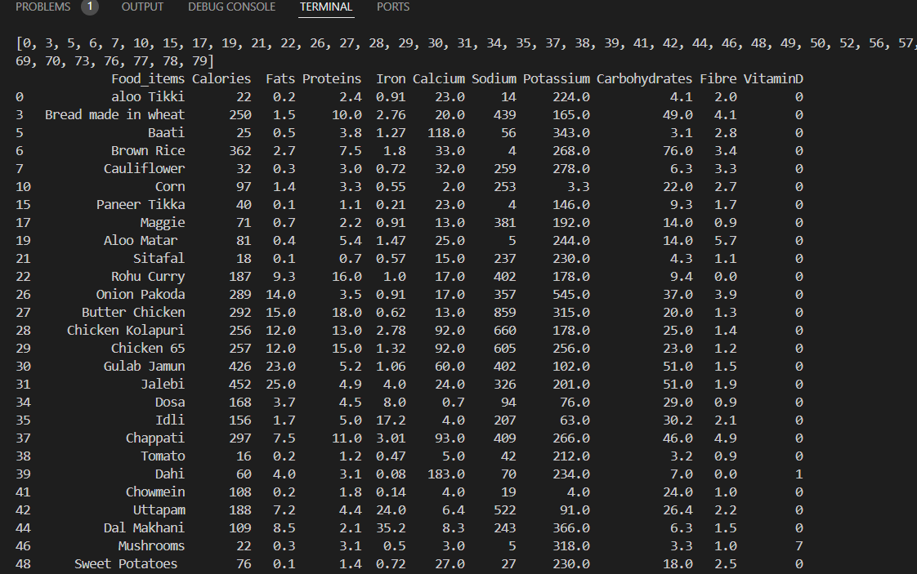
Diet Plan Section

Slide 9
Conclusion
The development journey of "AI FitHub - Revolutionizing Wellness with Intelligent Fitness Guidance" has been both challenging and rewarding. Through a meticulous process of research, design, and implementation, we have succeeded in creating a groundbreaking platform that leverages the power of artificial intelligence to transform the way individuals approach fitness and wellness. AI FitHub offers a personalized and adaptive approach to fitness guidance, empowering users to achieve their health goals in a more efficient and sustainable manner. The platform's intuitive user interface and advanced algorithms provide users with actionable insights, personalized workout recommendations, and real-time feedback, thereby enhancing their overall fitness experience. By seamlessly integrating AI technology with fitness guidance, AI FitHub not only addresses the unique needs and preferences of individual users but also fosters a sense of empowerment and motivation to pursue healthier lifestyles. In conclusion, AI FitHub represents a significant step forward in the quest for smarter, more personalized approaches to fitness and wellness. With its innovative features, user-centric design, and commitment to continuous improvement, AI FitHub is poised to revolutionize the way individuals engage with their health and fitness goals, setting a new standard for excellence in the digital fitness landscape.

Slide 10
References
1.PythonSoftwareFoundation.(2022).PythonDocumentation.Retrievedfromhttps://docs.python.org/3/
2.VanderPlas,J.(2016).PythonDataScienceHandbook.O'ReillyMedia, Inc.
3.Pedregosa,F.,Varoquaux,G.,Gramfort,A.,Michel,V.,Thirion,B.,Grisel,O.,...&Vanderplas, J. (2011). Scikit-learn: Machine learning in Python. Journal of MachineLearning Research, 12(Oct), 2825-2830.
4.McKinney,W.(2017).Pandas:DataStructuresforStatisticalComputinginPython.Proceedings of the 9th Python in Science Conference.
5.Fitbit.(n.d.).FitbitAPIDocumentation.Retrievedfromhttps://dev.fitbit.com/build/reference/
6.Google.(n.d.).GoogleFitAPIDocumentation.Retrievedfromhttps://developers.google.com/fit
7.Apple Inc. (n.d.). HealthKit. Retrieved fromhttps://developer.apple.com/documentation/healthkit

Slide 11
References
8.Grinberg,M.(2018).FlaskWebDevelopment:DevelopingWebApplicationswithPython. O'Reilly Media, Inc.
9.DjangoSoftwareFoundation.(2022).DjangoDocumentation.Retrievedfromhttps://docs.djangoproject.com/en/3.2/
10.MaterialDesign.(n.d.).MaterialDesignGuidelines.Retrievedfromhttps://material.io/design
11.Twitter,Inc.(n.d.).BootstrapDocumentation.Retrievedfromhttps://getbootstrap.com/docs/5.1/getting-started/introduction/
12.Heroku.(n.d.).HerokuDocumentation.Retrievedfromhttps://devcenter.heroku.com/categories/reference
13.AmazonWebServices.(n.d.).AWSDocumentation.Retrievedfromhttps://docs.aws.amazon.com/index.html

Slide 12
Thank You

